Slide 1

Outlines
Binary Multiplier
  2 bit X 2 bit
  4 bit X 3 bit
Magnitude Comparator
  1 bit
  2 bit
  4 bit

Slide 2
Binary Multiplier
Algo:
  Start from LSB
  Each digit (bit) of multiplier is multiplied with multiplicand
  Each such multiplication forms a partial product
  Successive partial products are shifted one position to the left
  The final product is obtained from the sum of the partial products

Slide 3
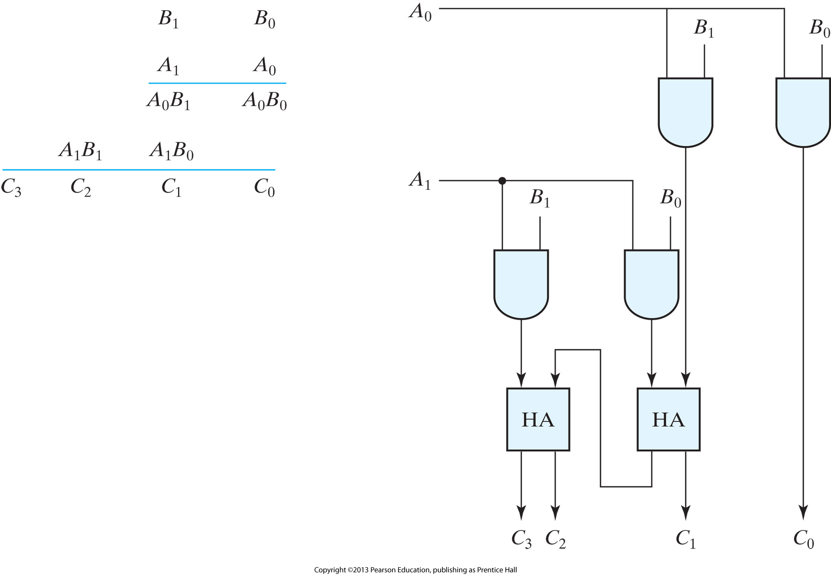
2 bit X 2 bit Multiplier

Slide 4
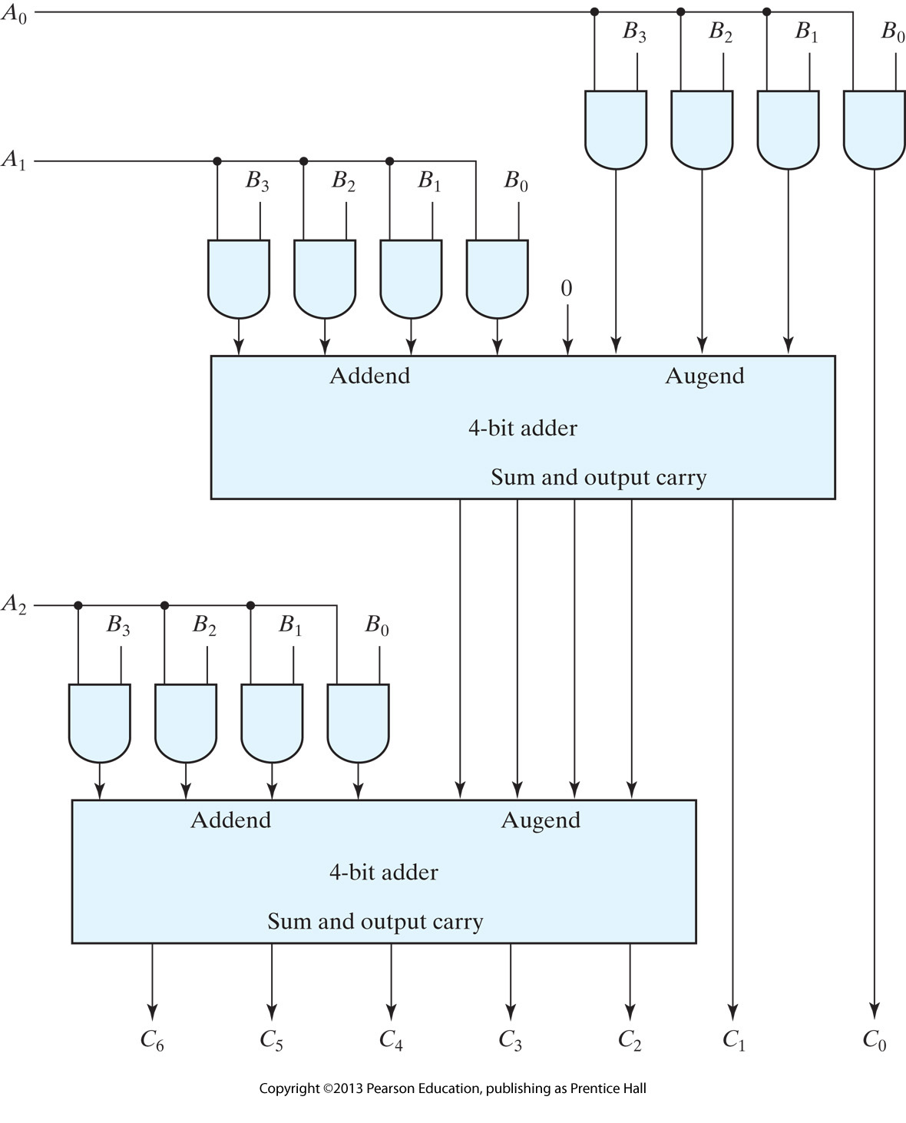
4 bit X 3 bit Multiplier

Slide 5
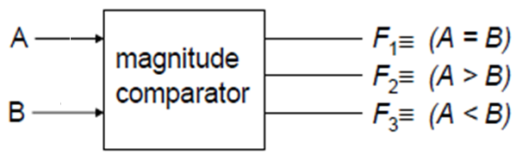
Magnitude Comparator
Basics:
  How many I/ps (at minimum)?
  How many possible O/ps?
If A=B, F₁ = 1
A₃A₂A₁A₀ B₃B₂B₁B₀
The symbols A>B and A<B are binary O/p variables that are equal to 1 when A>B and A<B respectively
Magnitude Comparator
A<B A=B A>B

Slide 6
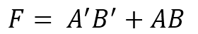
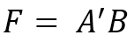

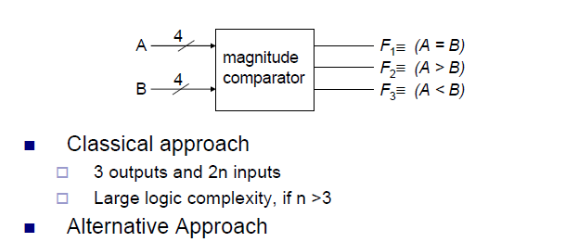
Magnitude Comparator (I/p: 1 bit)
Classical Design Approach (Truth Table):
A | B | A=B | A>B | A<B
0 | 0 | 1 | 0 | 0
0 | 1 | 0 | 0 | 1
1 | 0 | 0 | 1 | 0
1 | 1 | 1 | 0 | 0
1
1

Slide 7
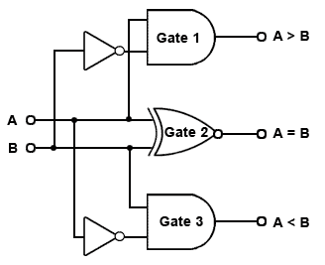
Magnitude Comparator (I/p: 1 bit)

Slide 8
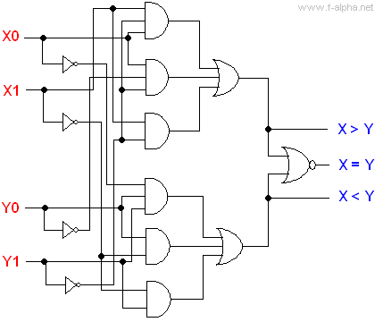
Magnitude Comparator (I/p: 2 bit)

Slide 9
Magnitude Comparator (I/p: 4 bit)
Classical Design Approach (Truth Table):
  A: 0000 – 1111 (16 combinations)- 2^{n}
  B: 0000 – 1111 (16 combinations)- 2^{n}
  A B: 16 x 16 entries in T/Table (2^{2n})

Slide 10
Magnitude Comparator
Alternate Approach:
  Write expression for three cases
  Consider two 4-bit numbers
For A=B:
A₃ = B₃
A₂ = B₂
A₁ = B₁
A₀ = B₀

Slide 11
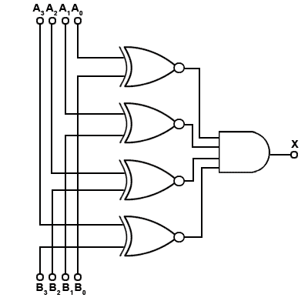
Magnitude Comparator
For A=B:

Slide 12
Magnitude Comparator
For A=B:

Slide 13
Magnitude Comparator
Algo. for A>B/A<B:
  Start from MSB
  If MSB (A) = MSB (B), check next bit
  Continue this until unequal bits are reached
  A/B = 0/1 (Binary – Easy comparison)
  If corresponding (unequal) bit of A = 1 and B = 0 (A>B)
  Other way around (A<B)

Slide 14
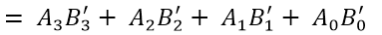
Magnitude Comparator
Write Expression for A>B:
From 1-bit comparator
So, in case of 4-bit comparator: the function will include:
However, (starting from MSB),
A₂, B₂ are compared iff A₃ and B₃ are equal (i.e. x₃ = 1)
If (MSB) A₃ and B₃ are not equal
(x₃ = 0), then we do not need to compare A₂ and B₂
To incorporate the algo., function
will be:

Slide 15
Magnitude Comparator
Write Expression for A<B:

Slide 16
Magnitude Comparator

Slide 17
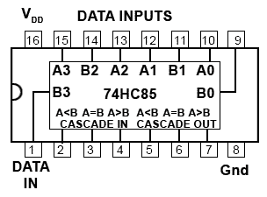
Magnitude Comparator

